Slide 1
BLUESTOCK FINTECH · CAPSTONE
Mutual Fund Analytics Platform
Full-stack data pipeline, risk modeling, and BI dashboard

Slide 2
Ecosystem Scale
Project baseline metrics and data volume.
46k+
₹12.5L
32k+
40
Daily NAV
Crore AUM
Transactions
Schemes
Historical pricing records.
Total anchor assets.
Investor activity logged.
Across 10 real AMCs.

Slide 3








ETL Pipeline Architecture
Automated extraction to BI deployment.
Extract
Transform
Load
Visualize
mfapi.in REST + CSV.
Pandas cleaning and metrics.
SQLite star schema.
4-page Power BI deployment.

Slide 4
Star Schema Architecture
Fully joinable, normalized tables for BI ingestion.
dim_fund
fact_nav
Core scheme master data.
46k+ daily history records.
fact_aum
fact_sip
Fund house market share.
Monthly retail inflows.
fact_transactions
fact_holdings
32k+ investor activities.
Sector and stock weights.

Slide 5

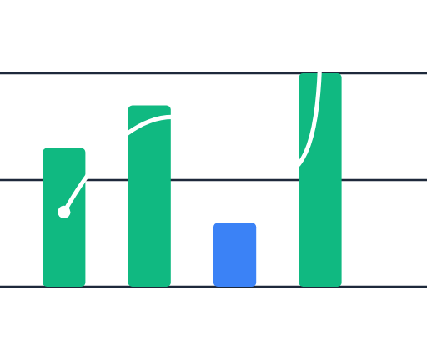
Exploratory Data Analysis
15+ Visualizations
Comprehensive Python notebooks.
Trend Identification
Mapping core market movements.
Distribution Normality
Validating statistical assumptions.

Slide 6
Risk & Performance Modeling
Quantitative outputs generated via Python data science logic.
Sharpe & Sortino
Value at Risk (VaR)
Risk-adjusted return profiling.
95% confidence downside boundaries.
Max Drawdown
Alpha & Beta
Historical downside exposure metrics.
Nifty 50 benchmark correlations.

Slide 7

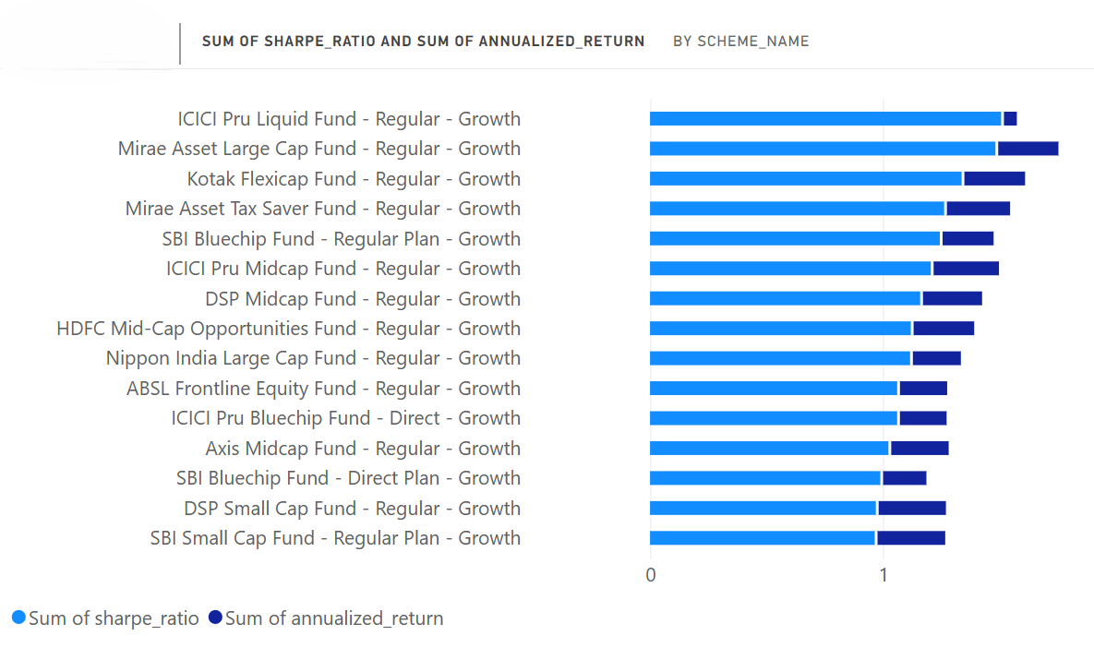
POWER BI DASHBOARD
Page 1:
Market Overview
Rankings: Top performing funds.
AUM: Market share across AMCs.
Inflows: ₹31k Cr SIP growth trend.

Slide 8
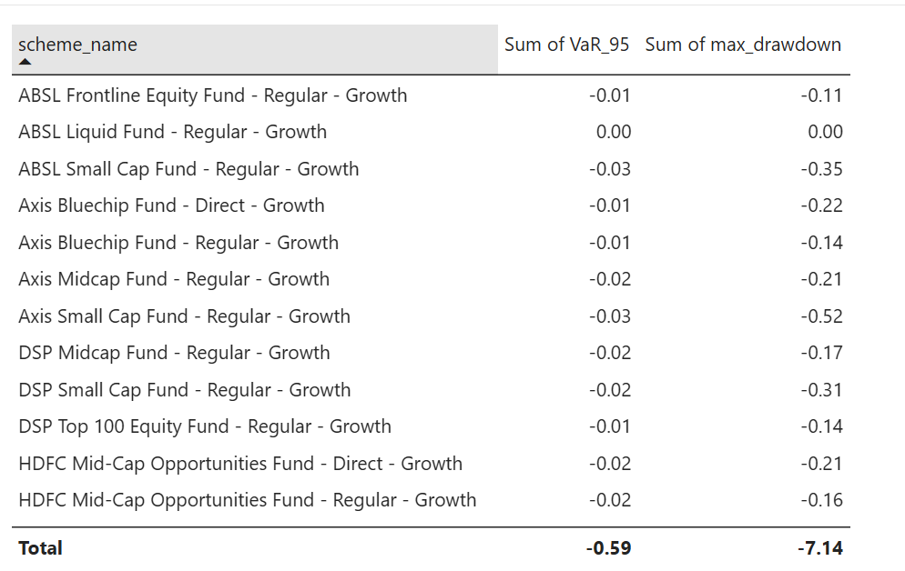
POWER BI DASHBOARD
Page 2:
Risk & Performance
Risk Table: var_drawdown_summary.
Scatter Plot: Sharpe vs Sortino.
Downside: Maximum drawdown visual.

Slide 9
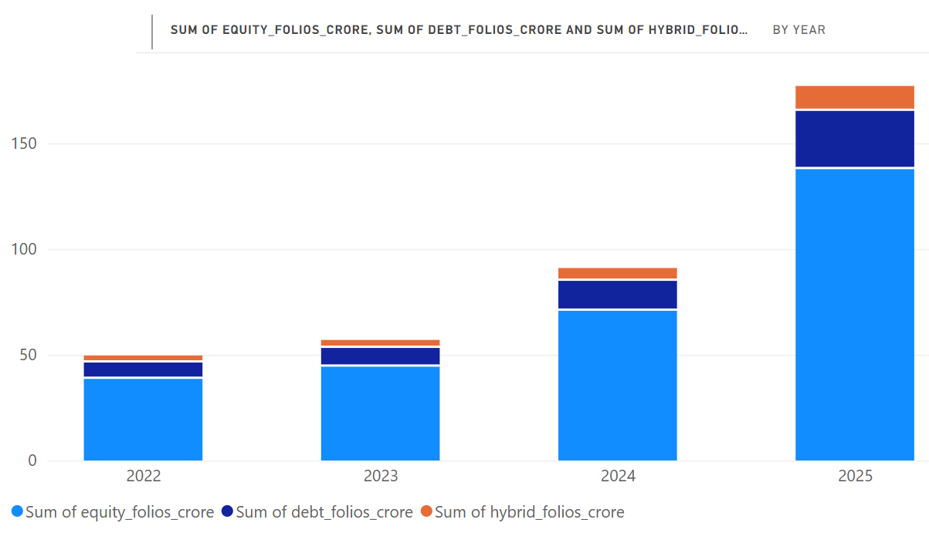
POWER BI DASHBOARD
Page 3:
Demographics
Categories: Debt, Equity, Hybrid folios.
Geography: Tier-2 city expansion map.
Age Brackets: 31% under-30 investors.

Slide 10
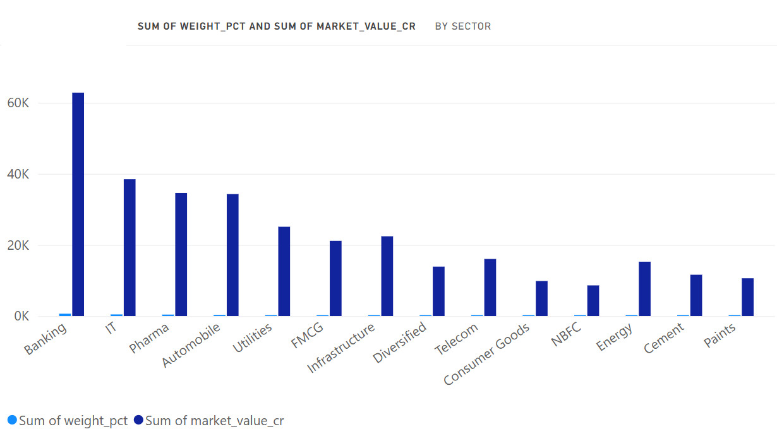
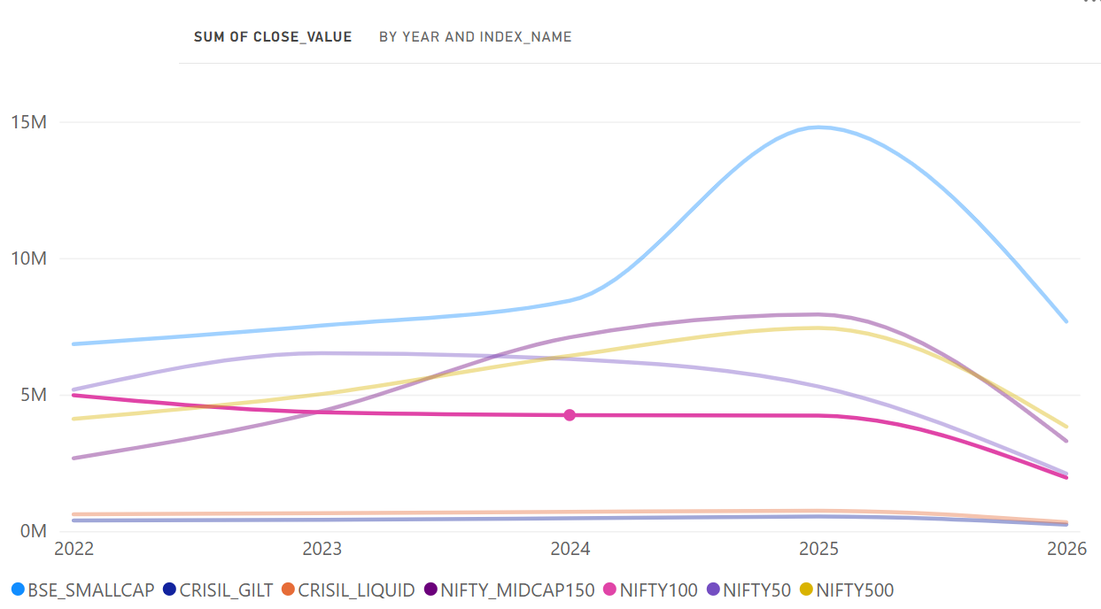
POWER BI DASHBOARD
Page 4:
Holdings & Benchmarks
Holdings: Sector concentration bar chart.
Benchmarks: Nifty 50 and Nifty 100.
Variance: Tracking error comparisons.

Slide 11




Key Findings & Business Insights
Mid-Cap Alpha: Structural outperformance captured despite volatility.
Regional Shift: Accelerated 2.5x growth recorded in Tier-2 regions.
Youth Adoption: 31% of ecosystem participants are under 30.
Equity Dominance: Vast majority of accounts active in equity folios.

Slide 12
Pipeline Complete
End-to-end analytics platform successfully deployed, satisfying all capstone objectives.
Future: Real-time API streaming
Future: Automated alerts
/https://github.com/VigneshBura/mutual-fund-analytics

